Slide 1
IHC – Cloud Architecture Assignment No. 2

Slide 2
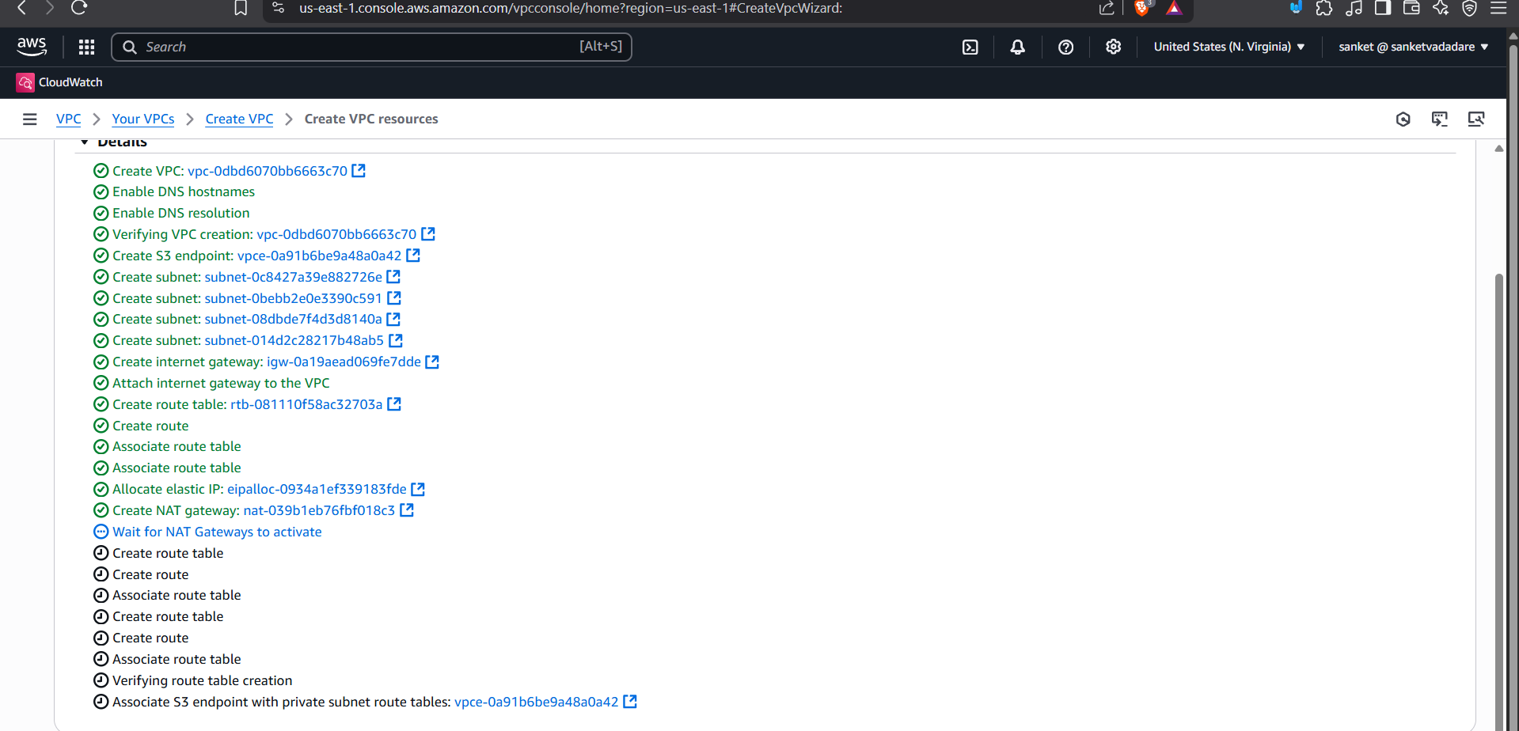
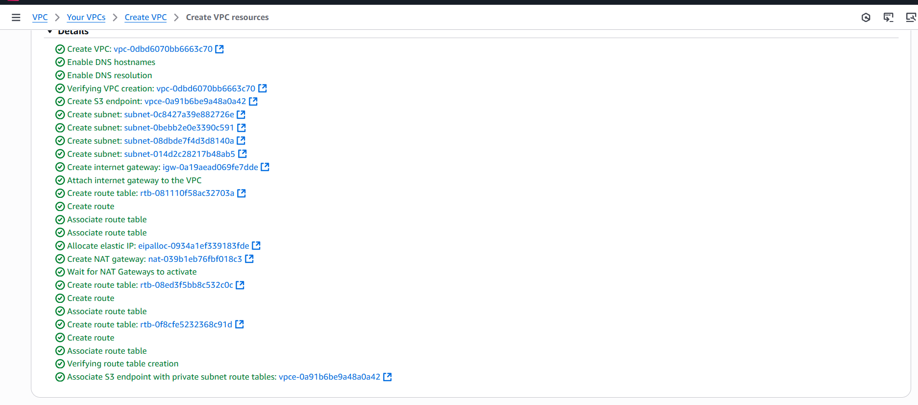
Notes:
Create vpc , 2 public ,2 private subnet . Route table ,nat gateway etc

Slide 3
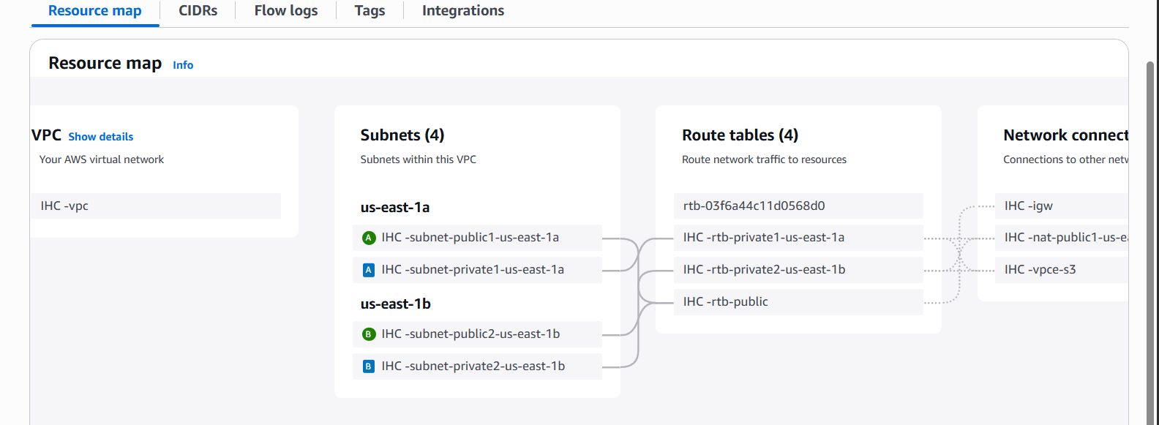

Slide 4
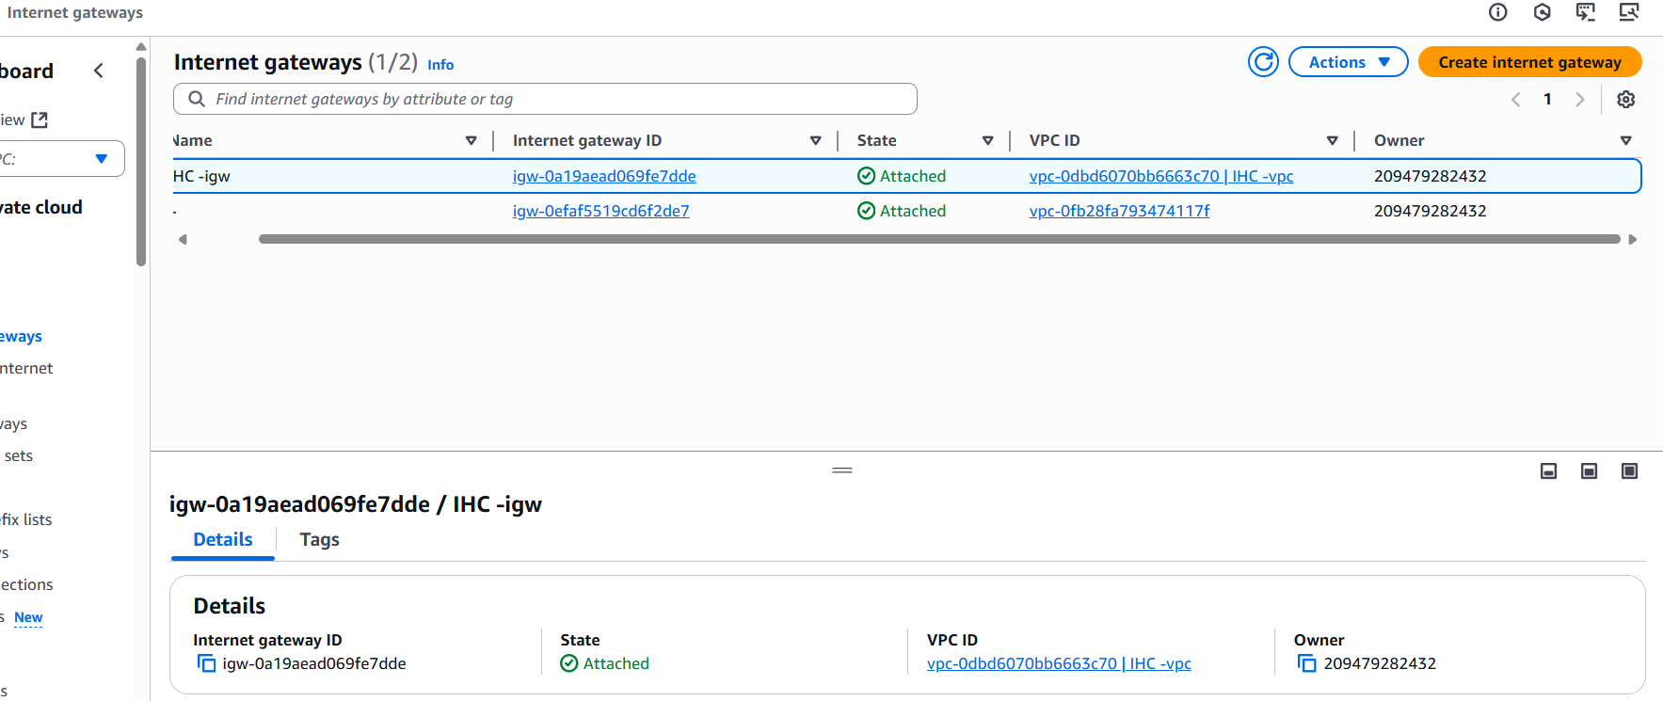
Notes:
Internet gatway alredy attach vpc

Slide 5
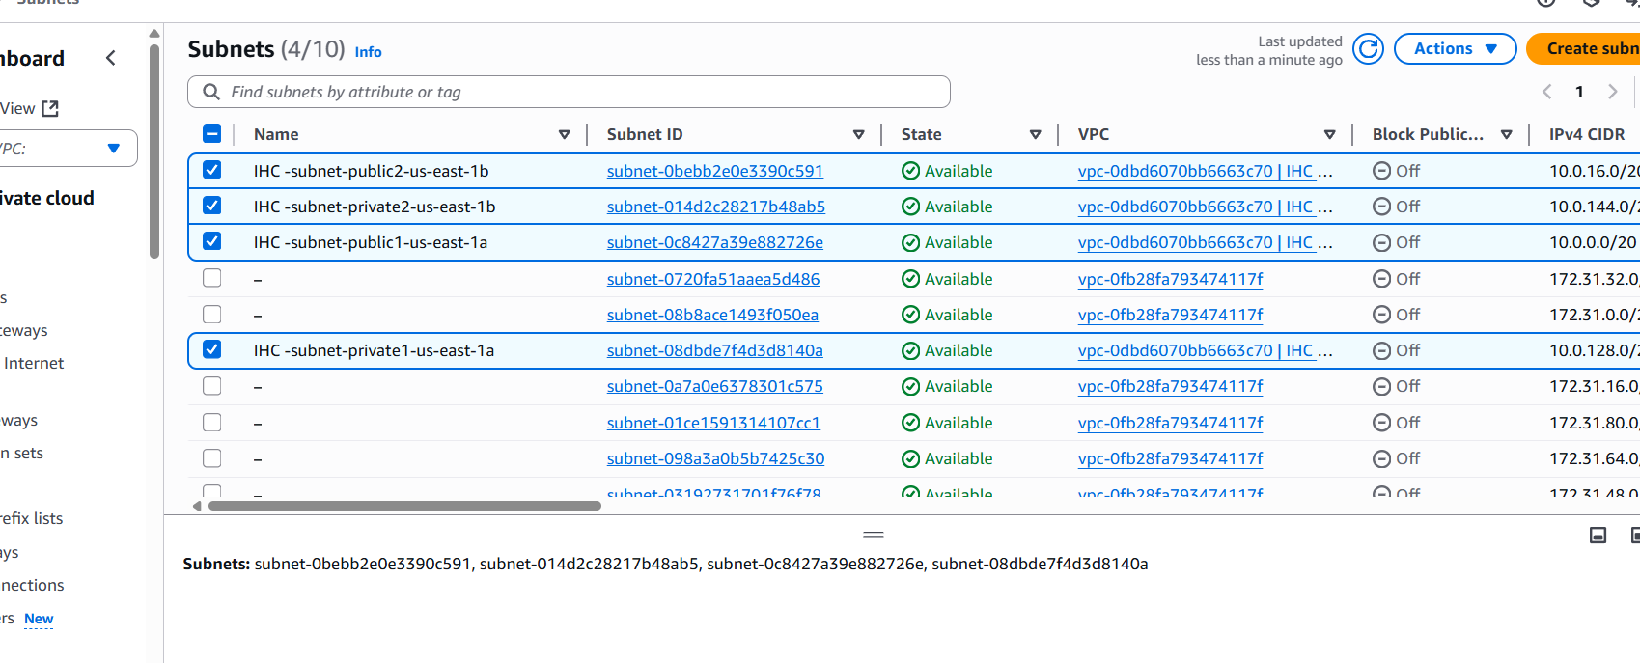
Notes:
Subnet , I am use 1 npublic and 1 private subnet and 1 backup private subnet

Slide 6
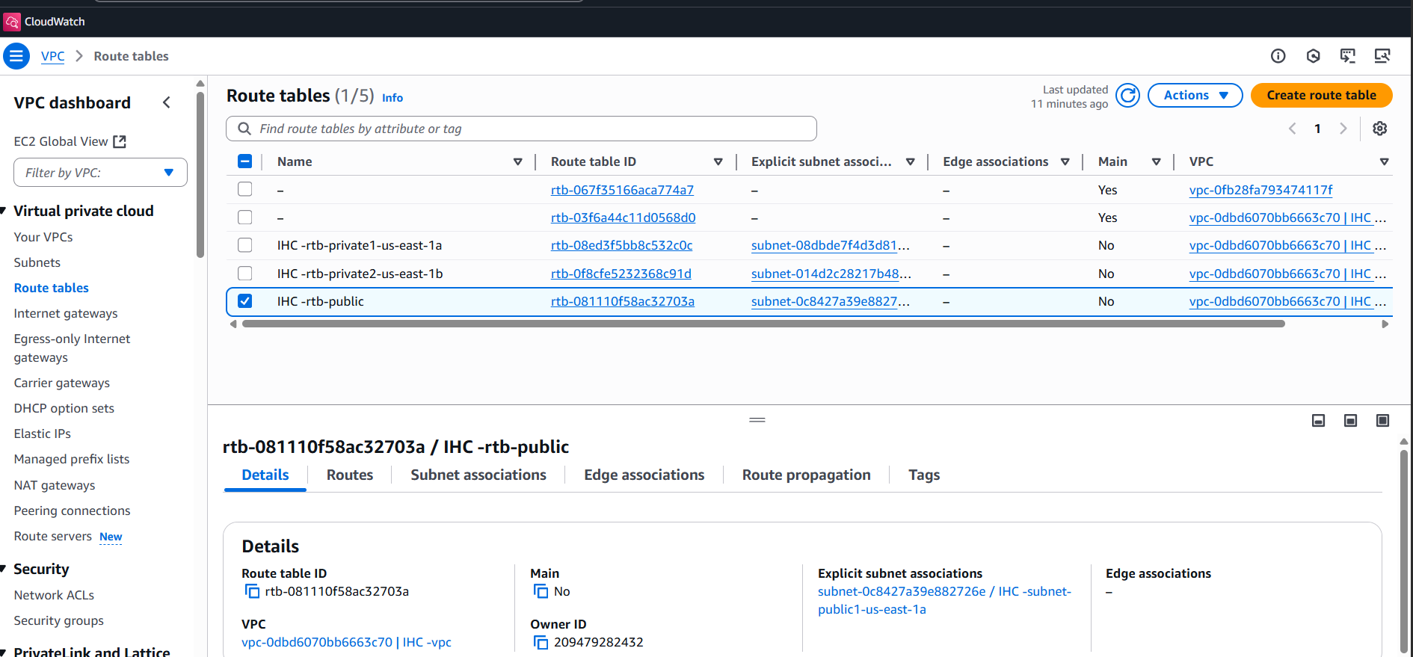
Notes:
Route table

Slide 7
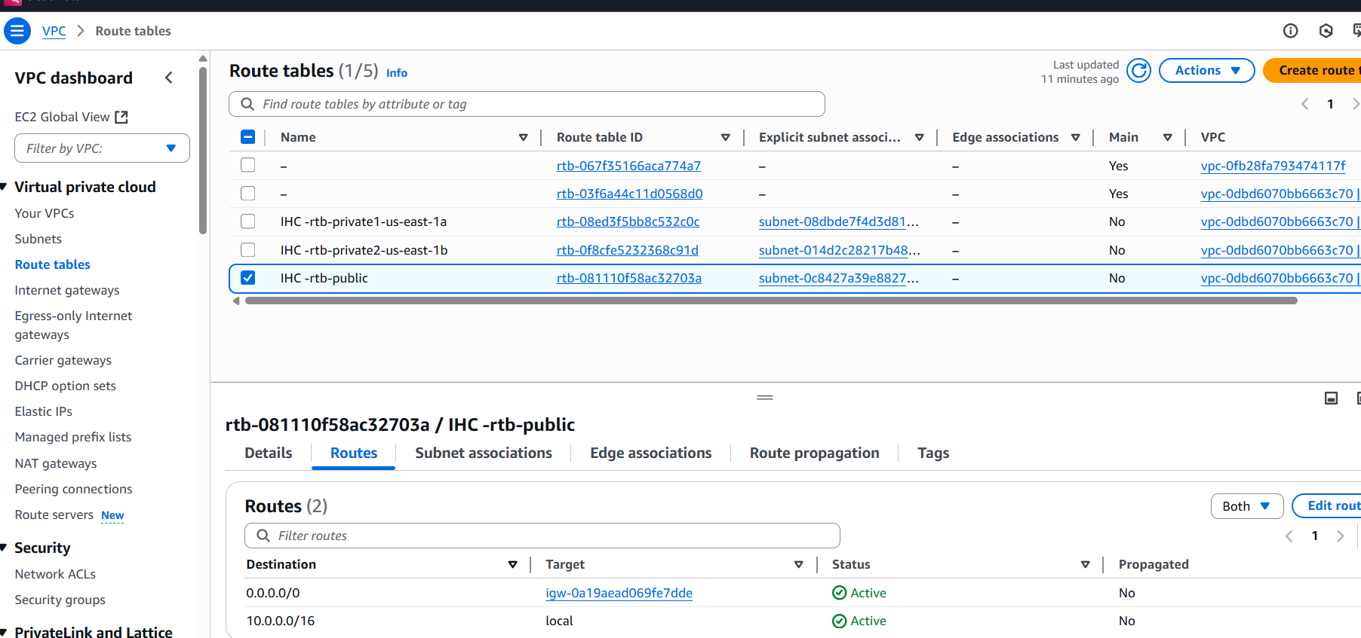
Notes:
Internet getway connect only us east 1 a public

Slide 8
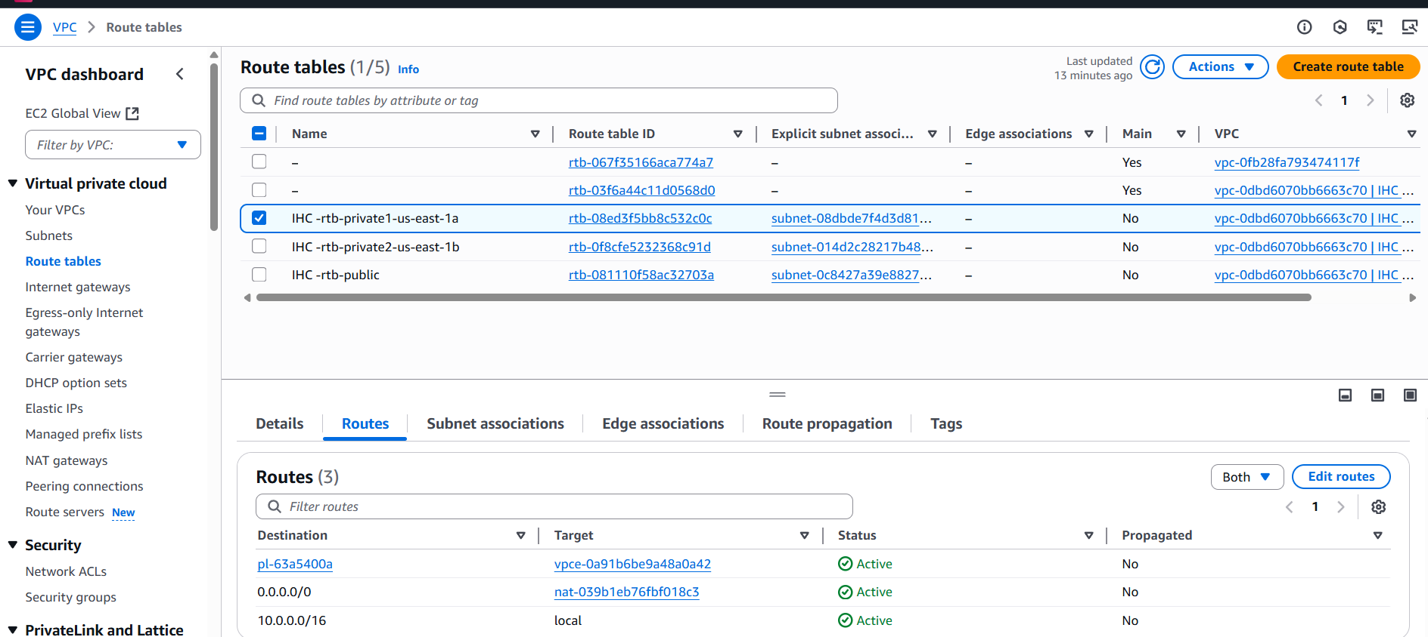
Notes:
Private subnet connect with nat gatewy

Slide 9
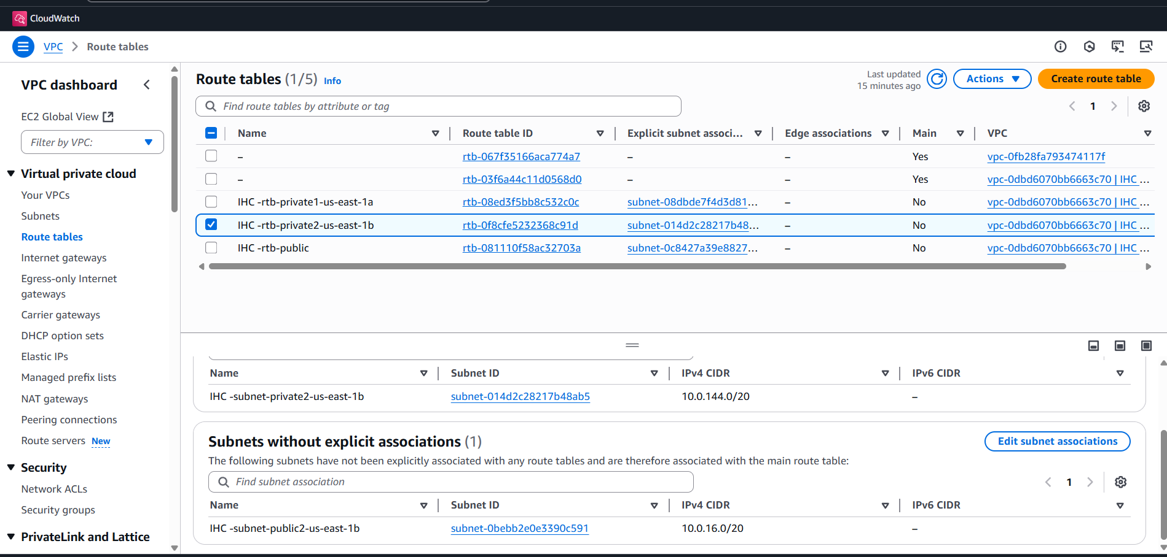

Slide 10
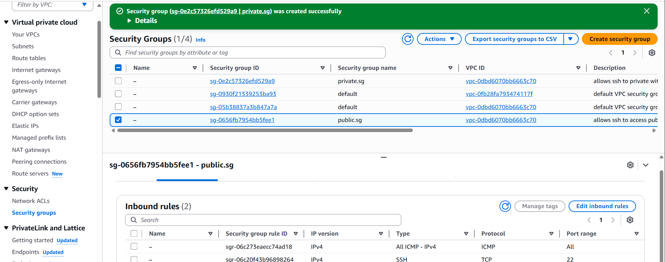
Notes:
Create security group public.sg for public access

Slide 11
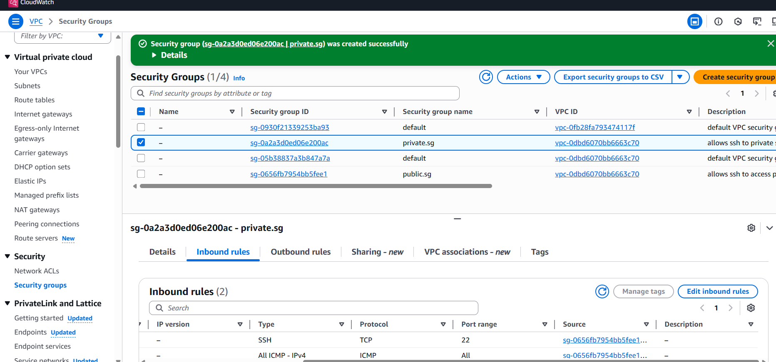

Slide 12
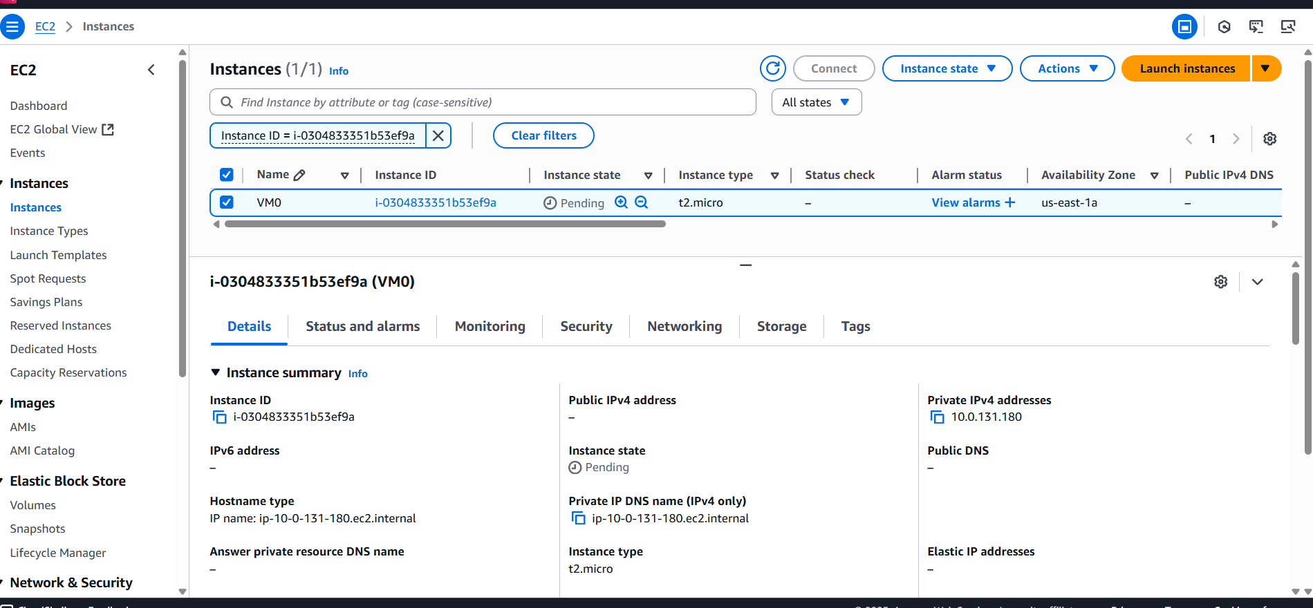
Notes:
Launch instance in private subnet us east 1 a

Slide 13
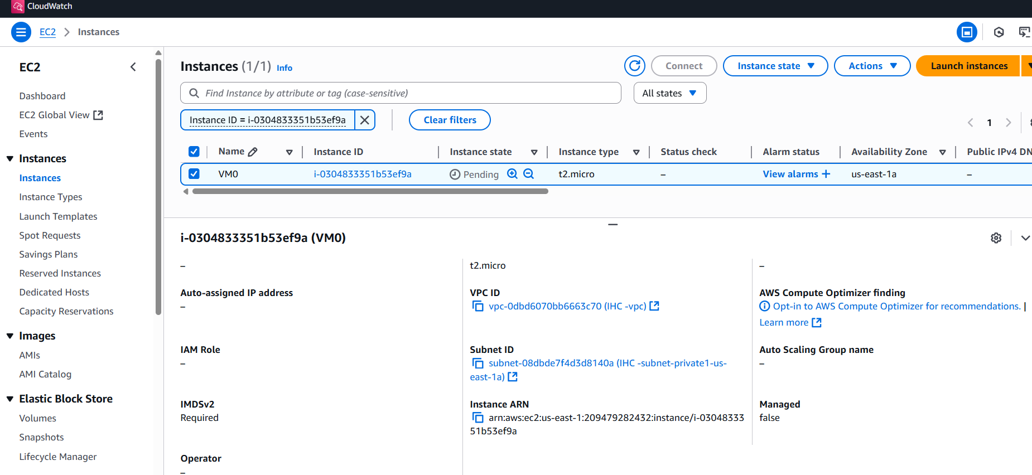

Slide 14
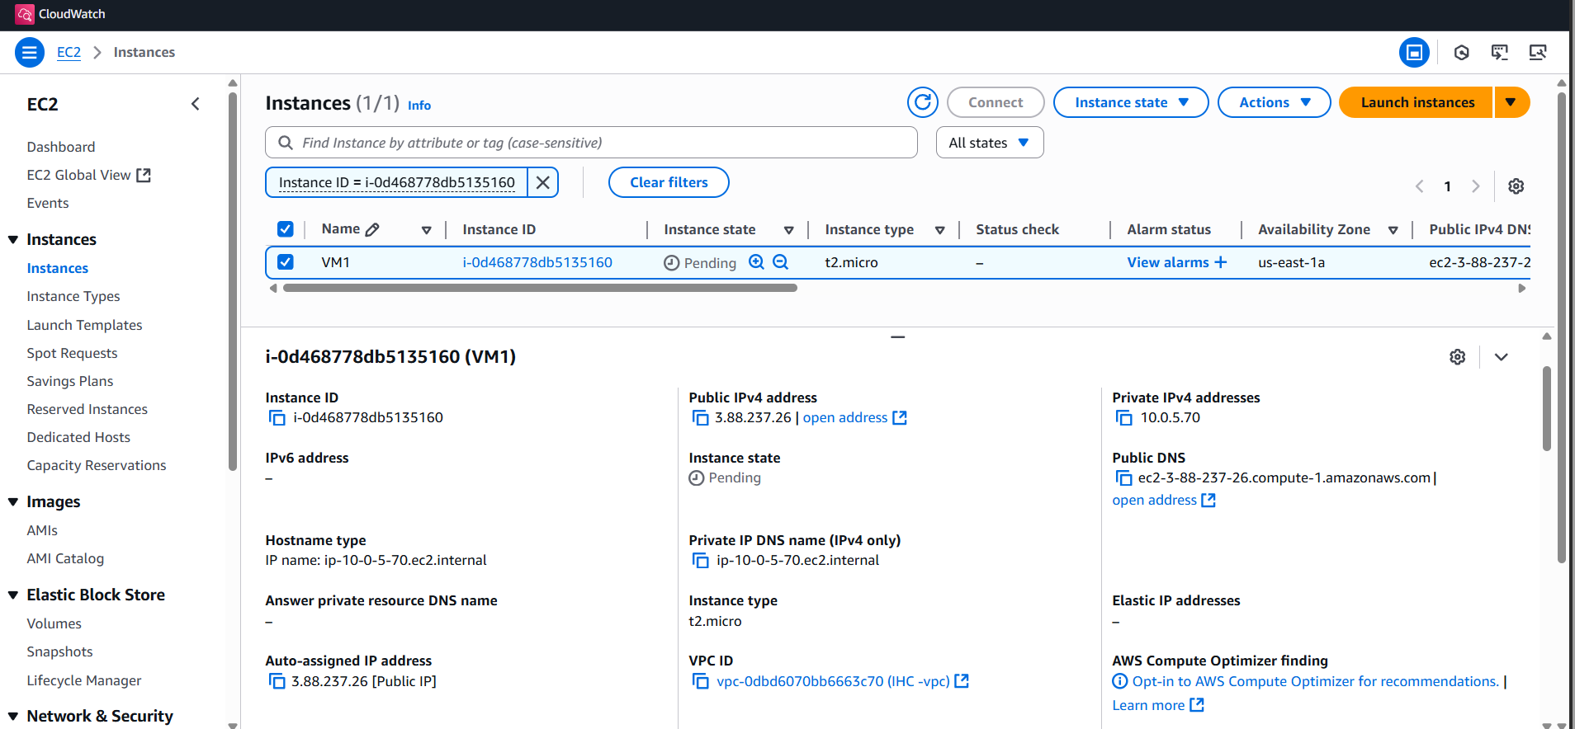
Notes:
Launch VM1 instance in public subnet in us east 1a

Slide 15
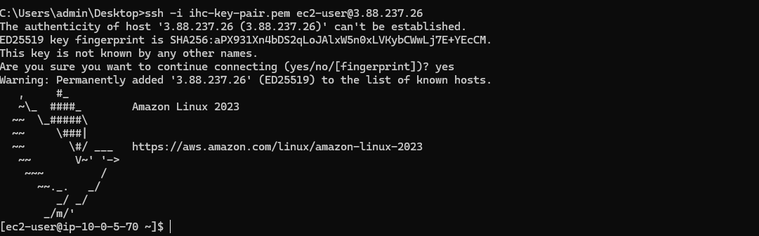
Notes:
VM1 open in ssh public subnet

Slide 16
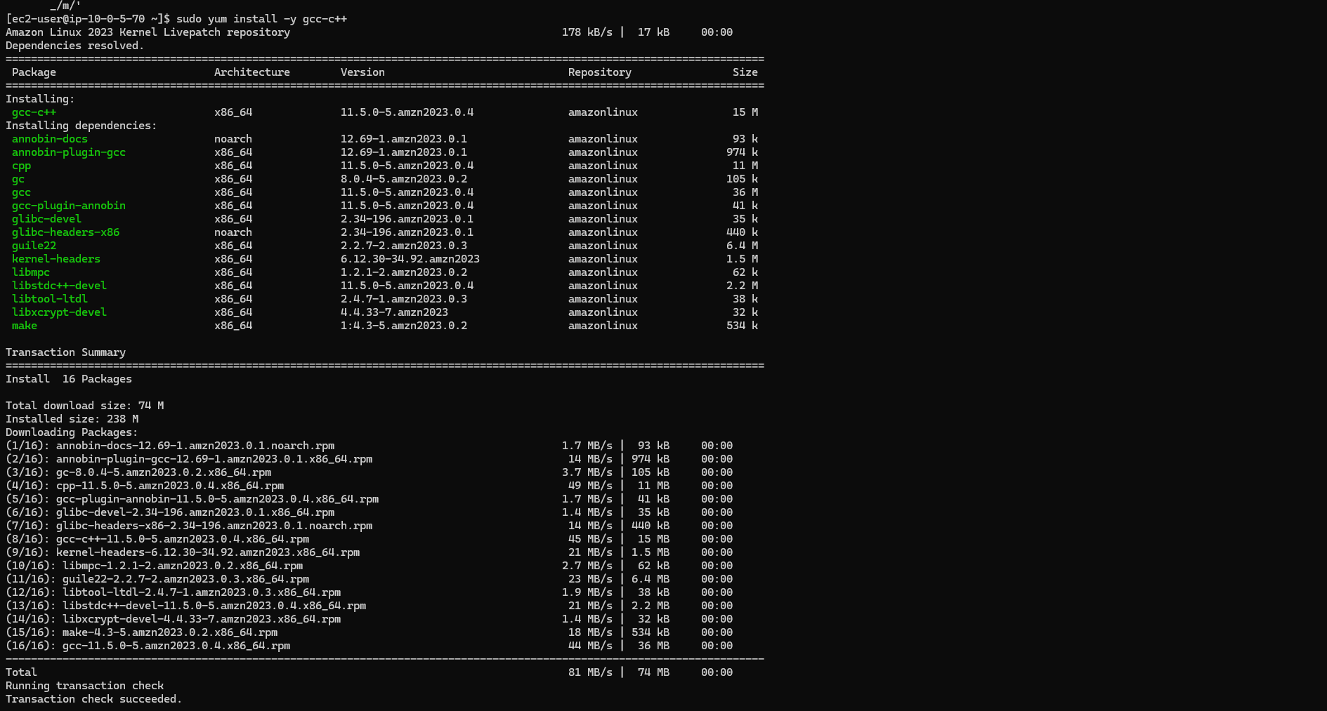
Notes:
install -y gcc-c++

Slide 17
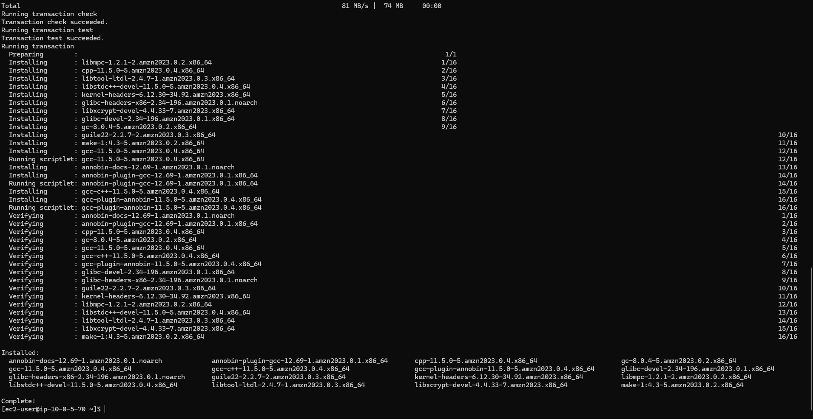

Slide 18
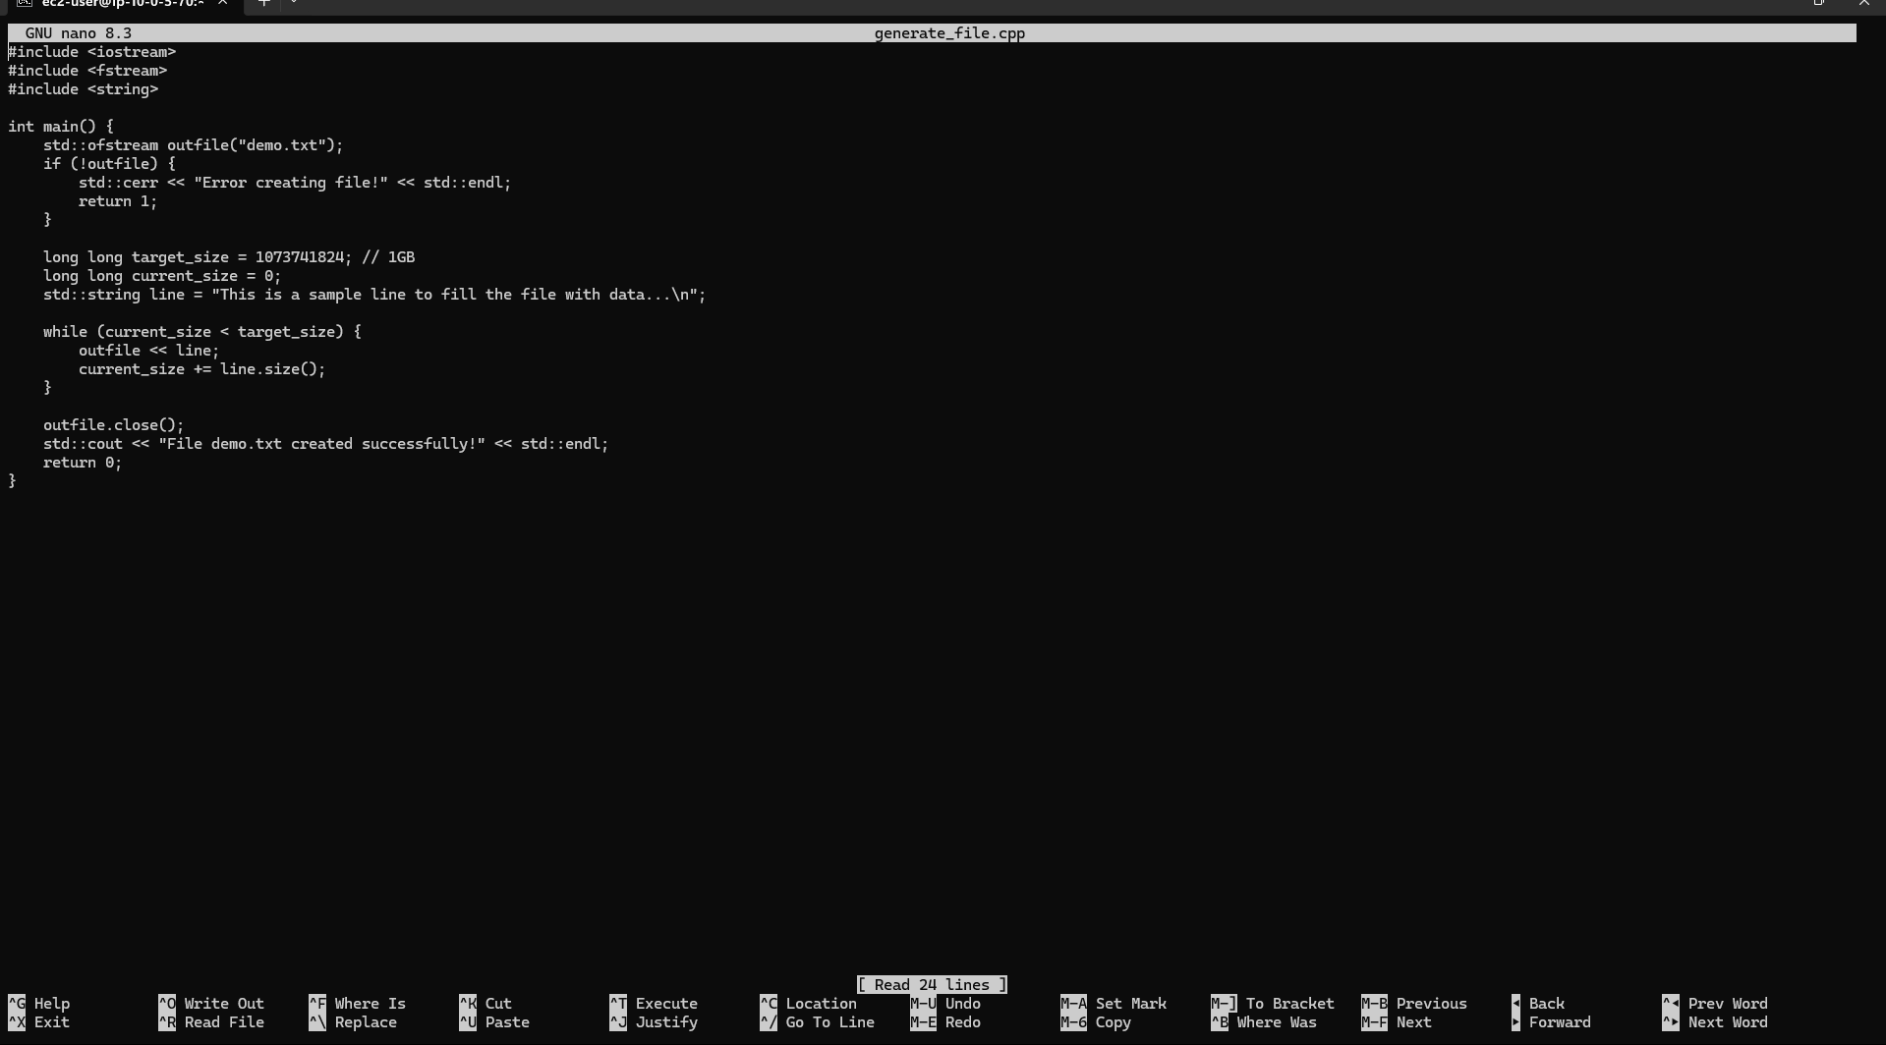
Notes:
Create nano generate_file.cpp

Slide 19
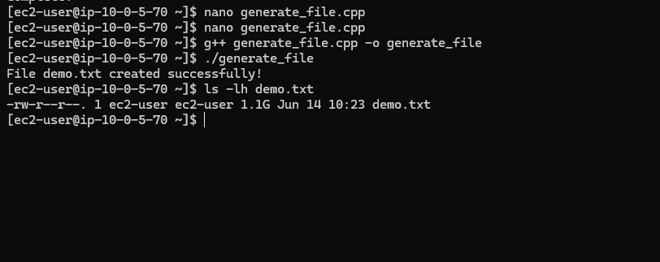
Notes:
Create demo.txt 1gb file

Slide 20
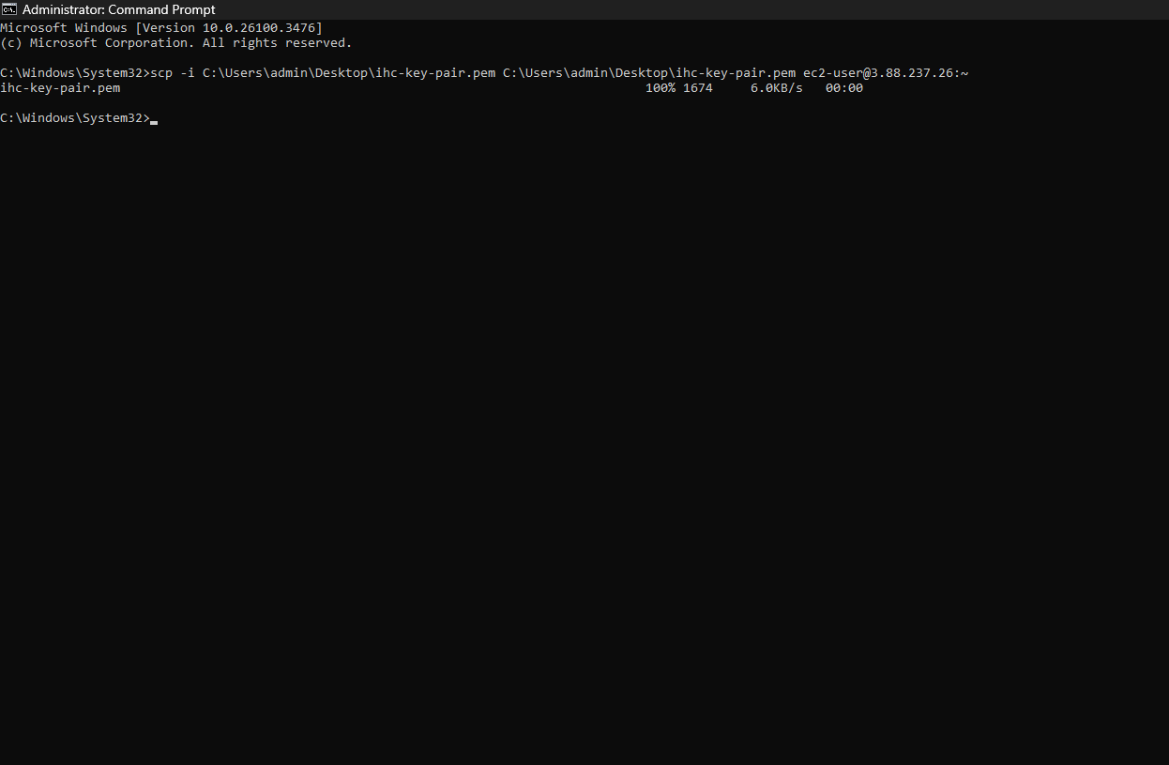
Notes:
Copy key pair my desktop to my public subnet instance VM1

Slide 21
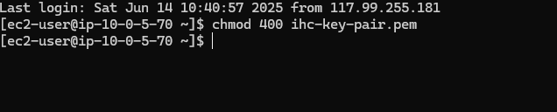
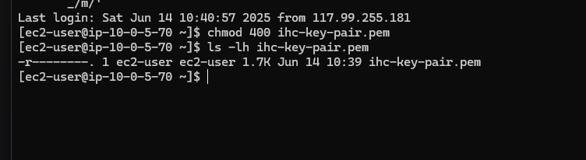
Notes:
Changing permission jey with ssh rule

Slide 22
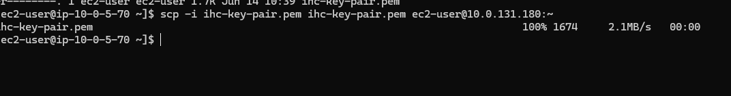
Notes:
Successfully copy key pair VM1 to VM0

Slide 23
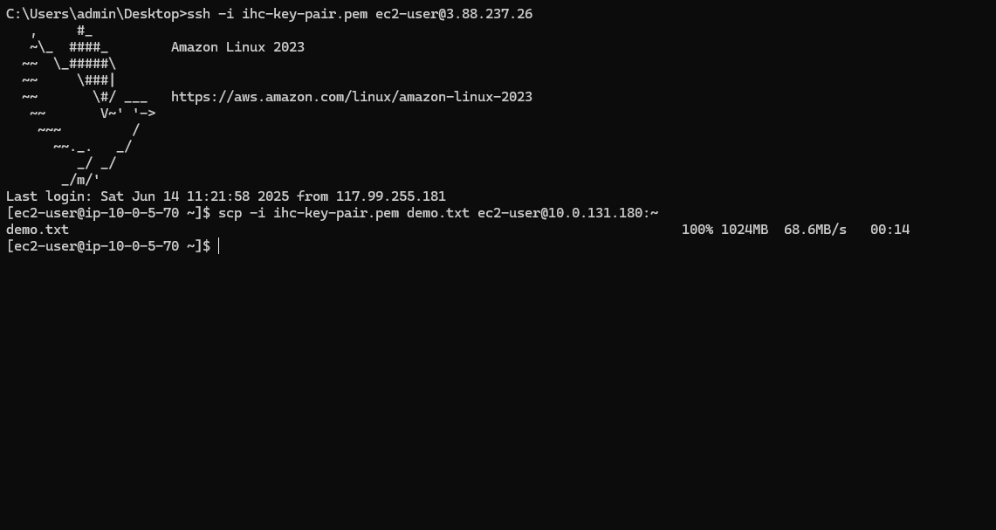
Notes:
Demo.txt file successfully copy vm1 to vm0

Slide 24
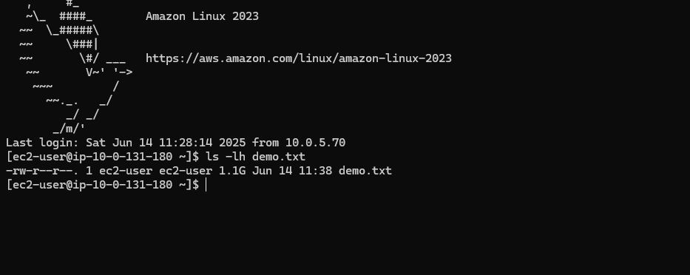
Notes:
Demo.txt file in provate instance

Slide 25
Notes:
Remove demo file from public instance vm1

Slide 26
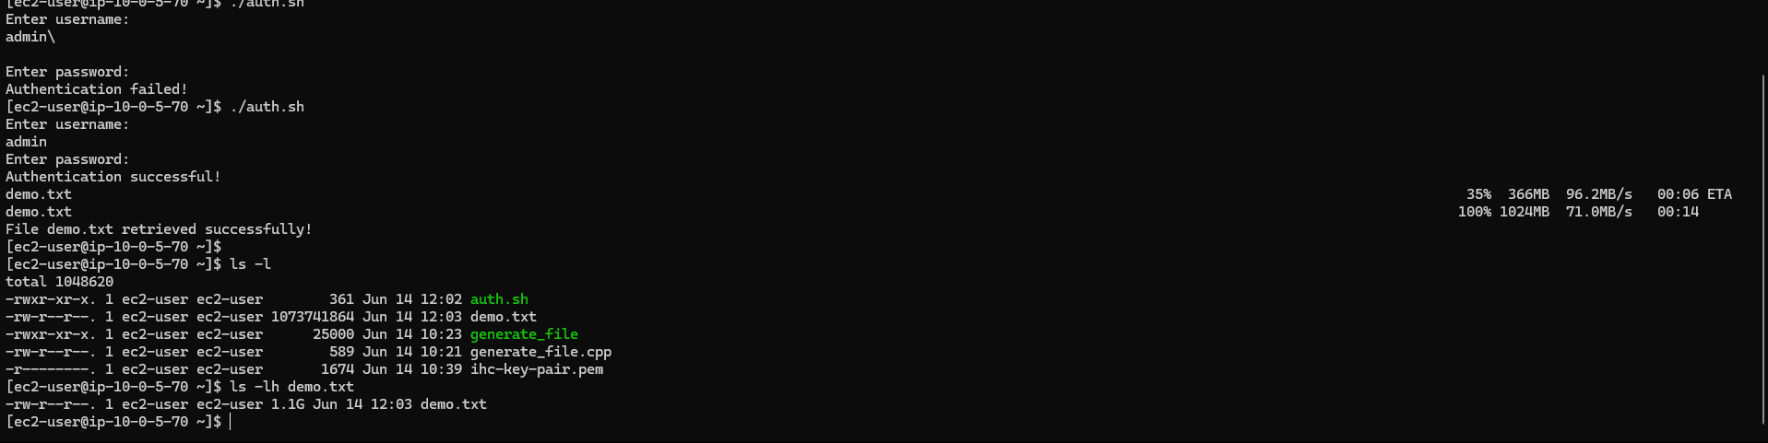
Notes:
Succesfuuly retrive femo.txtfile from vm0 pricate to vm1 public

